Slide 1
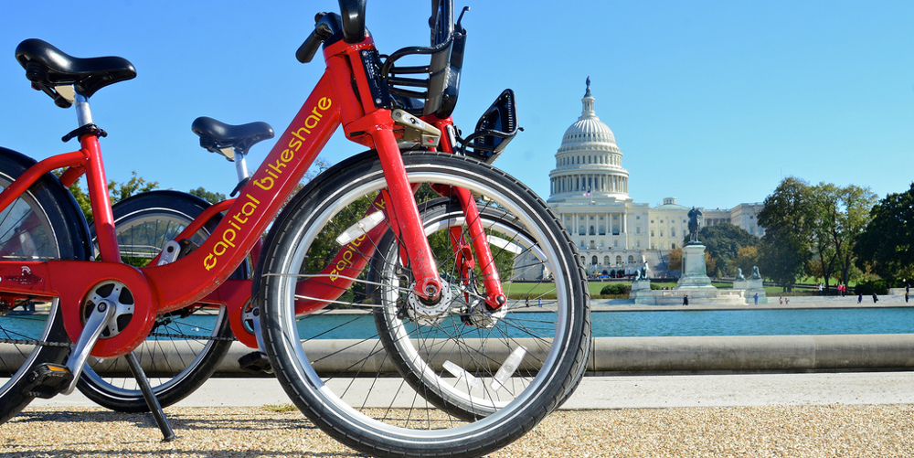

Data
Kimball Wu
Pei-Yi Cheng
Ling Tan
Sumeet Mishra
Notes:
Sumeet

Slide 2
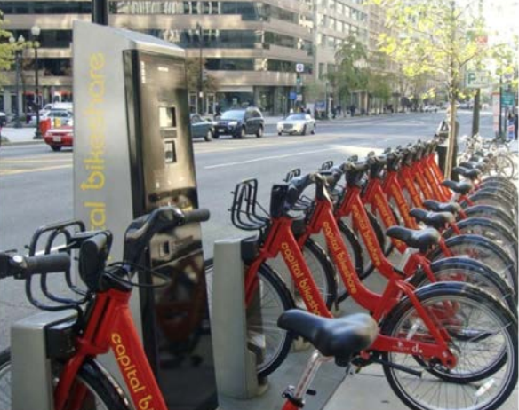
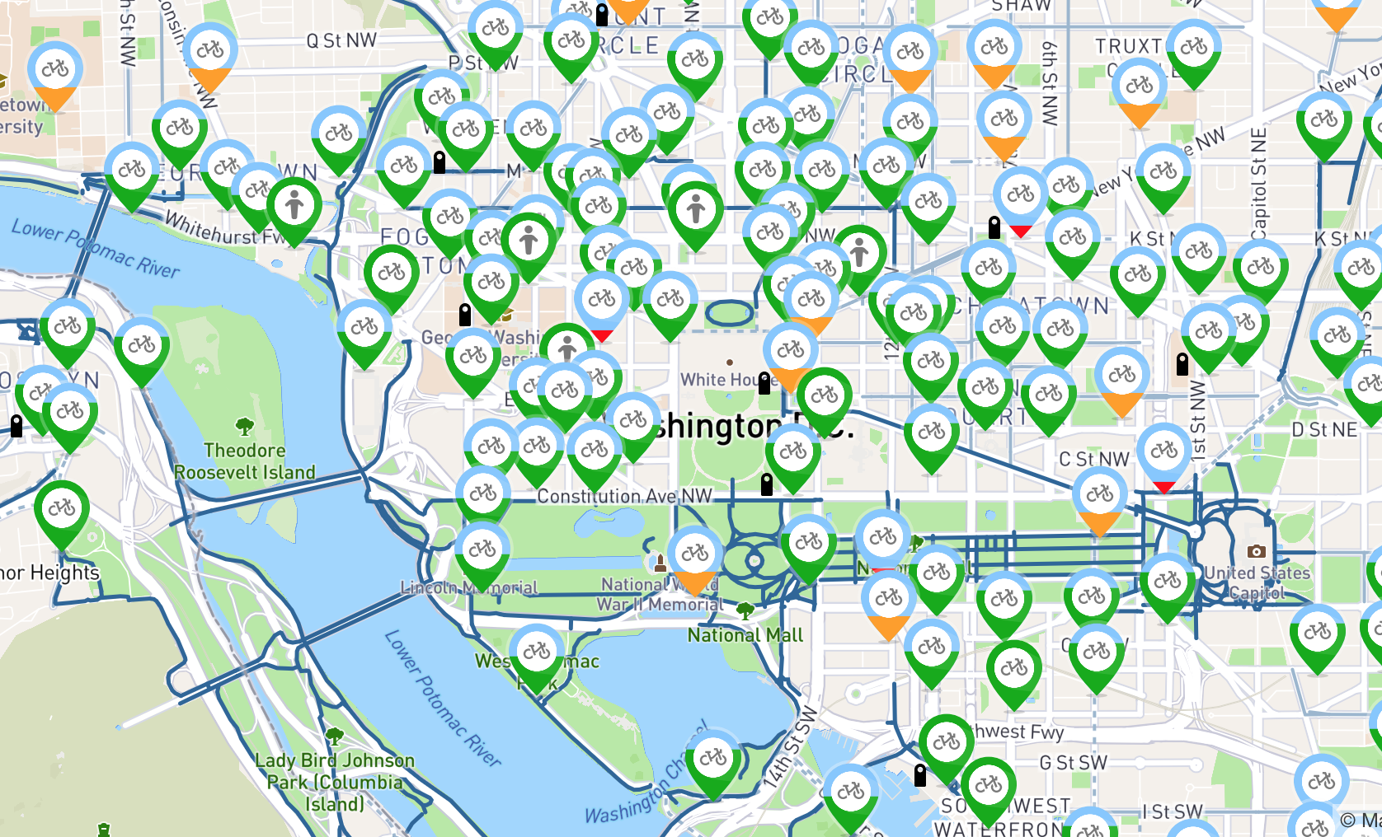
Notes:
Sumeet

Slide 3
Introduction
We are going to answer the following questions:
Capital Bikeshare has provided an eco-friendly alternative way to commute around D.C other than taking the Metro or driving.
We want to bring more profit to the company, by analyzing traveling behavior of bike usage:
Introduce new promotions that would interest Capital Bikeshare (potential) users.
Decrease bike maintenance cost.
Notes:
Sumeet
Time
Weather variations
Type of membership

Slide 4
Backgrounds
Data Collection
Hourly (and daily) bike rental counts between years 2011 and 2012
With weather and seasonal information
Dataset & Attributes
Response variable
Count
Temporal variables
Hour
Workingday
Weekday
Month
Year
Weather variables
Temperature
Humidity
Windspeed
Weather
Membership variables
Casual User (Single Trip & Pass)
Registered (Yearly or Monthly Membership)
Notes:
Sumeet weather
Indicates whether user was a "registered" member (Annual Member, 30-Day Member or Day Key Member) or a "casual" rider (Single Trip, 24-Hour Pass, 3-Day Pass or 5-Day Pass)

Slide 5
We need to explore the following relationships:
How is the bike usage affected by:
Type of Days
Seasons
Different type of Weather Conditions
Temperature, Humidity
Notes:
Sumeet

Slide 6
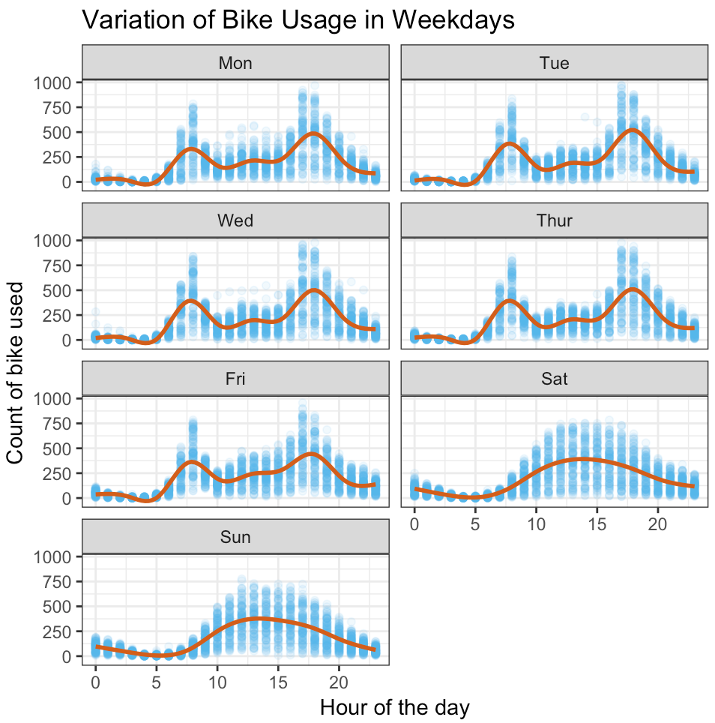
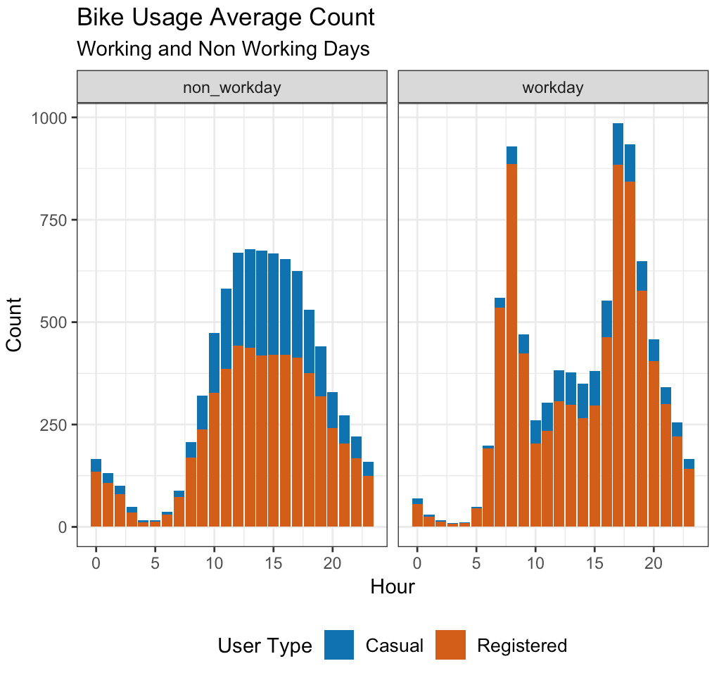
How bike usage is affected by different day of and hour
Notes:
Sumeet tourist

Slide 7
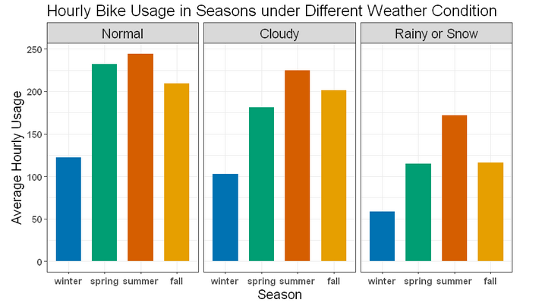
How bike usage is affected by different season and weather
Notes:
kimball

Slide 8
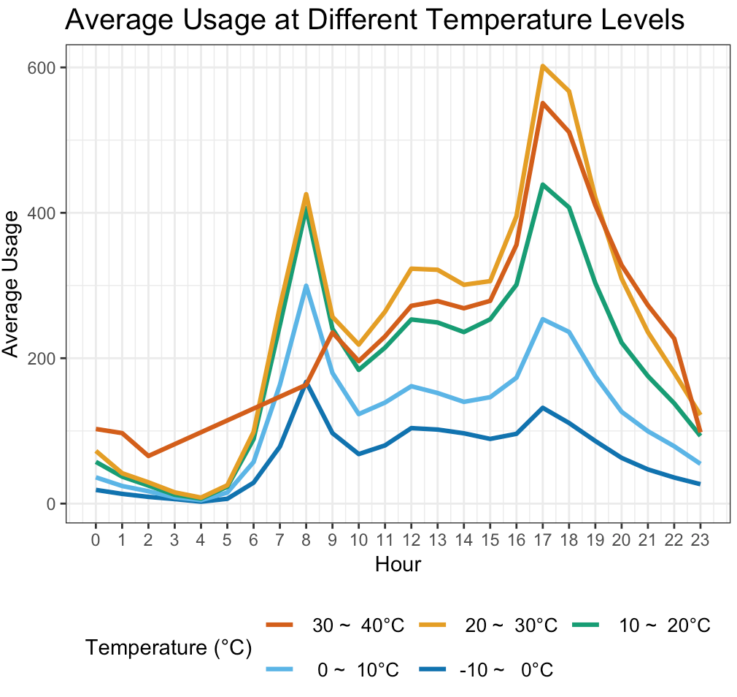
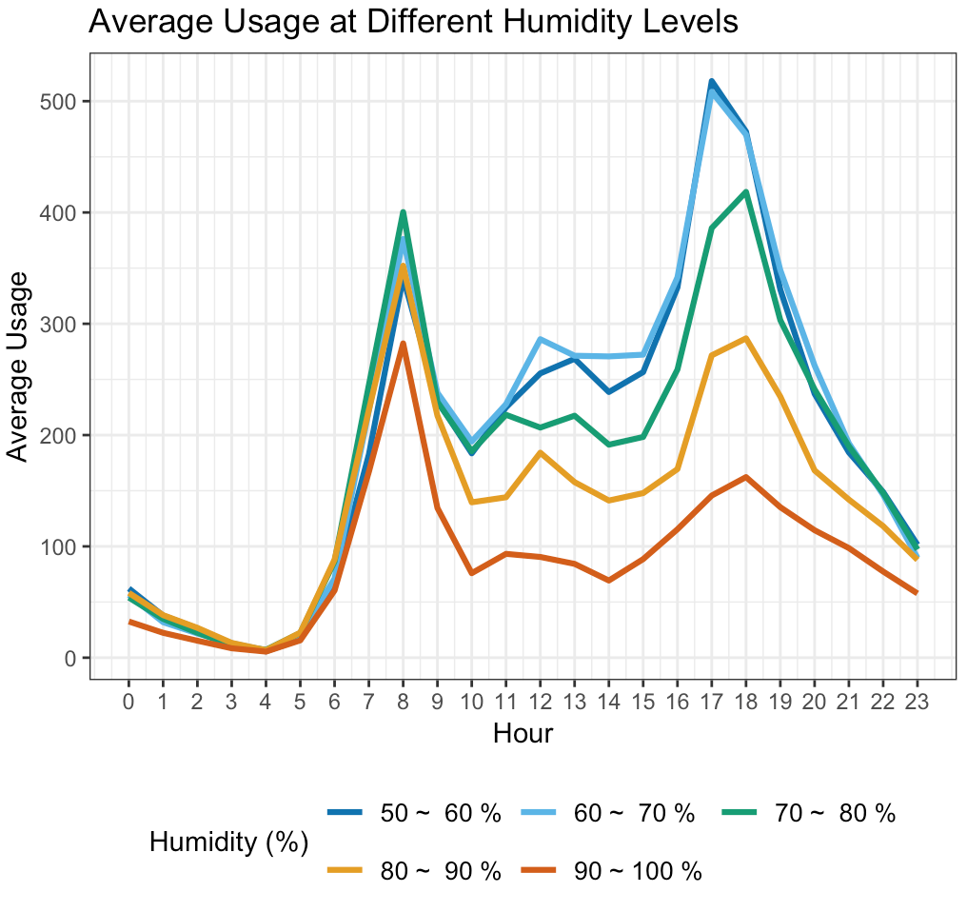
How bike Usage are Affected by
Temperature and Humidity Levels on Average
Notes:
Kimball

Slide 9
What we know about the bike usage so far...
Its hourly usage pattern is very different in work day and in non-work day
Two peaks v.s. One peak
Causal user shows up in non-work day.
It drops considerably when rain or snow
People like to ride in summer, hate to ride in winter. Fall and spring fall in between. Difference conditions on type of weather.
It drops when temperature falls or humidity rises
With an exception that when weather is TOO hot
Notes:
Kimball

Slide 10
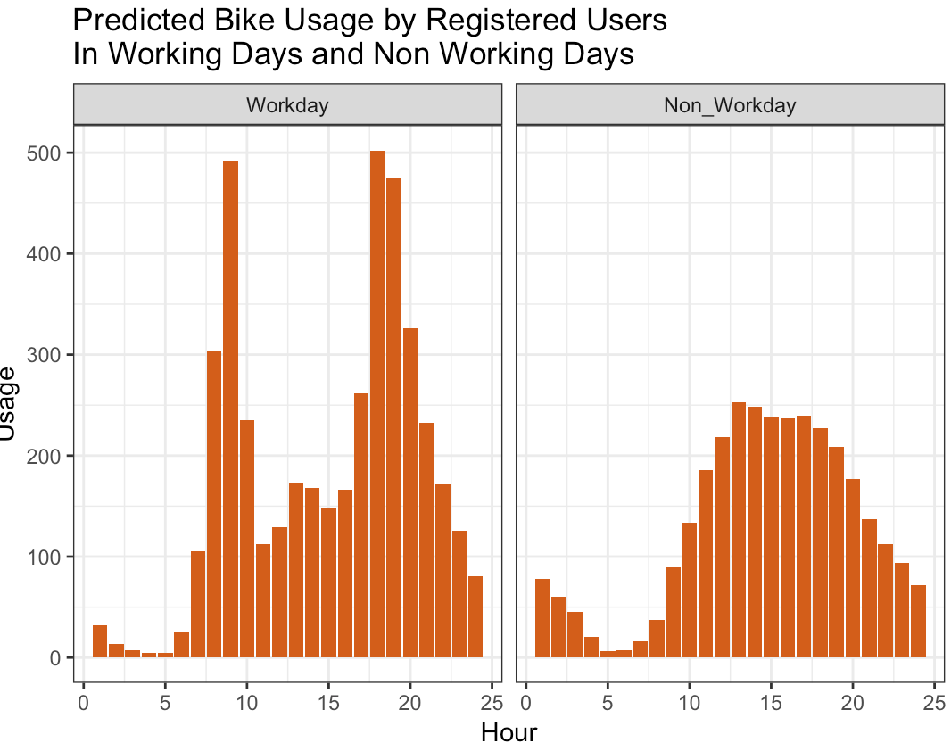
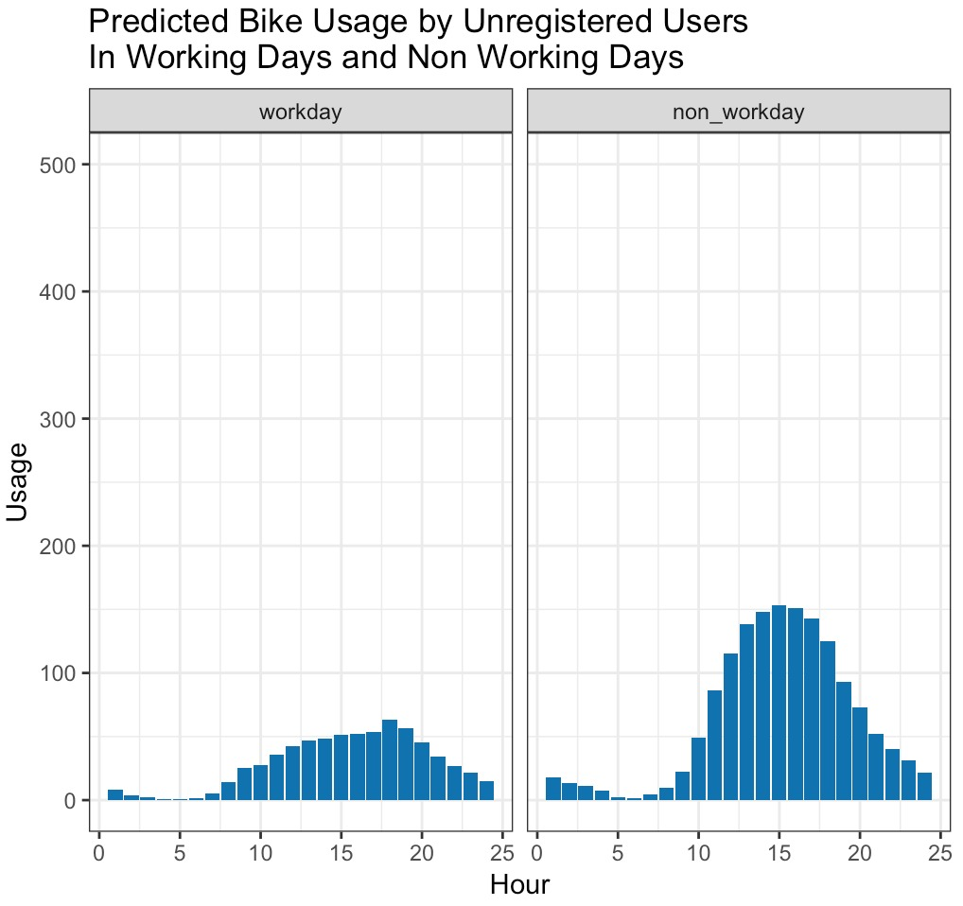
Poisson Prediction Model
Types of day x Hours + Normal Weather
Notes:
Ling and Sabrina

Slide 11
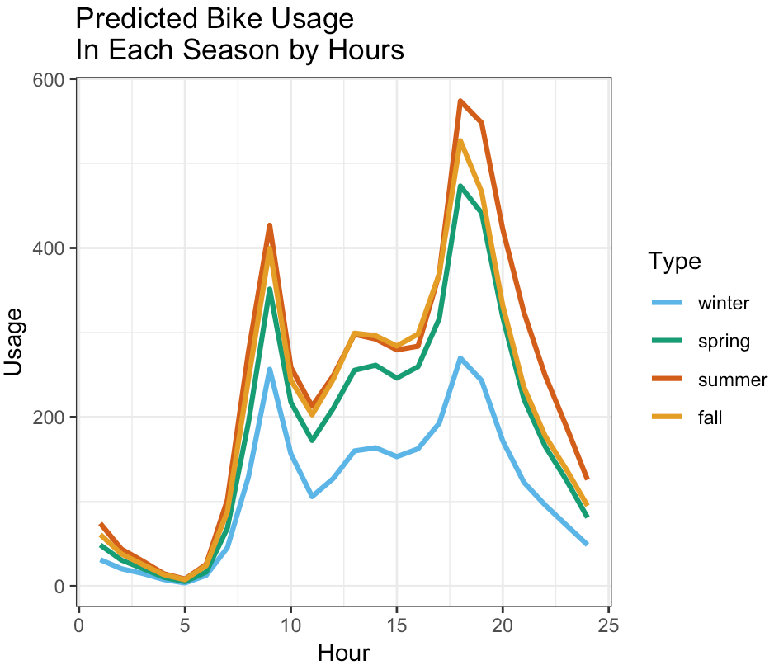
Poisson Prediction Model
Count = Season x Hours under Normal Weather
Seasons
Notes:
Ling and Sabrina

Slide 12
How good is our model?
Fixing overdispersion using Quasi-poisson Prediction Model
Residual Deviance Overdispersion
Baseline 1962000 175.2611
Types of day x Hours
Registered 330800 17.68
Casual 201900 27.72
Season x Hours 546400 38.09
Chi-Squared test with very small P-value Underfit
Notes:
Ling and Sabrina
we performed a chi-square hypothesis the model does not follow a poisson and it isn't a good fit.

Slide 13
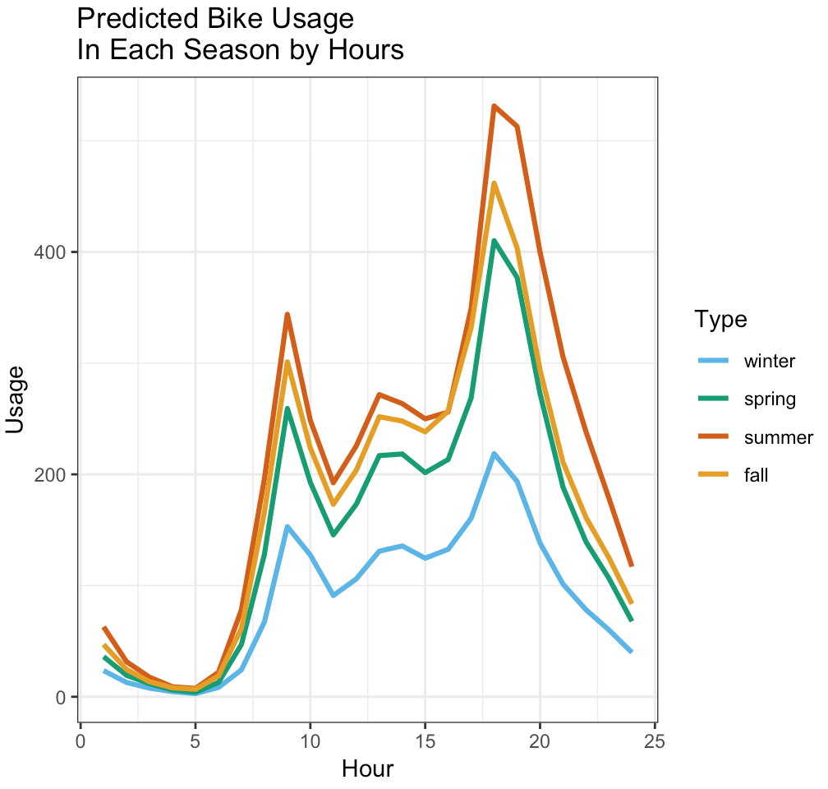
Quasipoisson Prediction Model
log(count) = Season x Hours under Normal Weather
Baseline
Residual Deviance 6668
Overdispersion: 0.474
Residual Deviance: 1723
Overdispersion: 0.1355995
Notes:
Ling and Sabrina

Slide 14
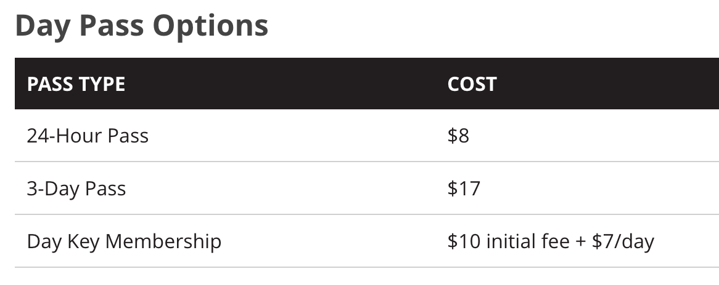
To answer the business questions - Promotions
Annual Membership
$85/year
30 Days Membership
$28/30 Days
We would introduce a Weekend Pass for $12
pass valid starting 0:01 am Saturday till 11:59 pm Sunday
We would introduce a Seasonal Membership for $35
Membership valid for 3 consecutive months
Corporate Memberships
Notes:
Ling and Sabrina

Slide 15
To answer the business questions - Maintenance
To save on maintenance cost by adjusting the number of bikes put out on the streets at a different time of a year. For example, reduce the number of bikes in winter by half of the amount from summer.
Notes:
Ling and Sabrina

Slide 16

Thank You
Reference: Fanaee-T, Hadi, and Gama, Joao, 'Event labeling combining ensemble detectors and background knowledge', Progress in Artificial Intelligence (2013): pp. 1-15, Springer Berlin Heidelberg

Slide 17
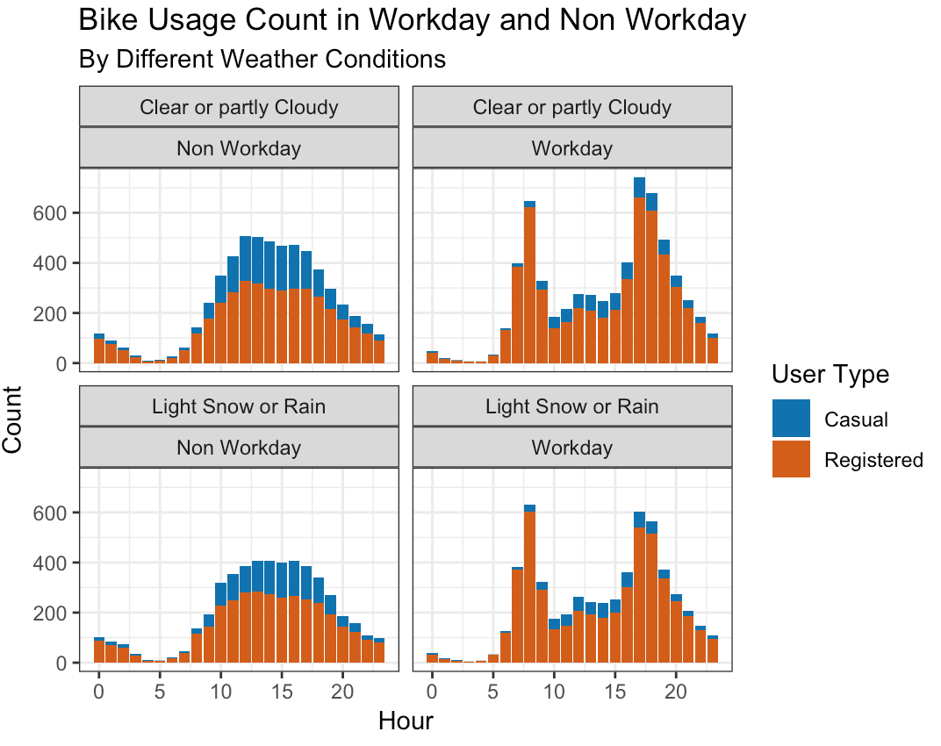
How bike Usage are Affected by
Weather Conditions and Type of Days
Notes:
Kimball

Slide 18
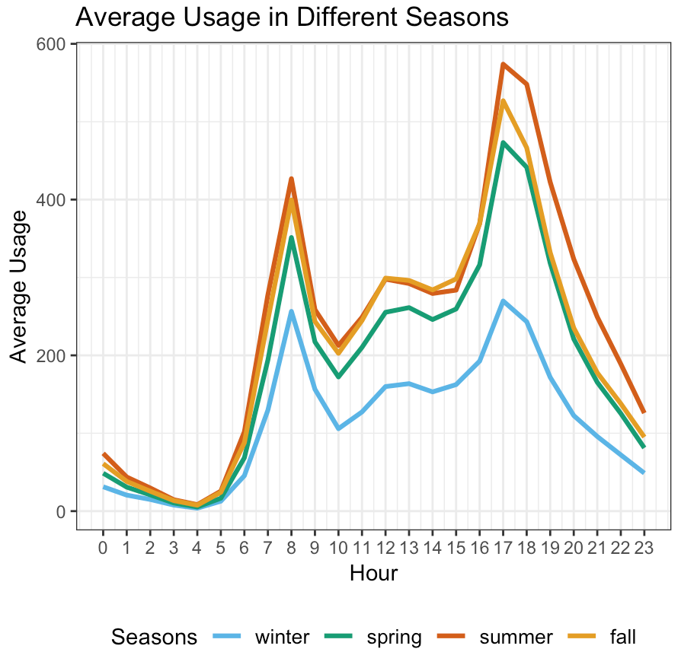
How bike Usage are affected by seasons
Notes:
Kimball

